Slide 1
DRAIN MANAGEMENT SYSTEM USING INTERNET OF THINGS
TEAM NUMBER – 19
K PRASHANTH 20071A04N3
S SAI DEEKSHITH 20071A04Q0
CH SHIVA 20071A04K2
Project Guide
Mr. C. KAUSHIK
(Assistant Professor)

Slide 2
CONTENT
Abstract
Introduction
Problem Statement
Objectives
Methodology
Results
Conclusion and Future Work
References

Slide 3
ABSTRACT
The proposed ideas solve the problems faced by the municipality work force during heavy rainfall. These systems help the municipality control room to better monitor the on-field situation of the drainage.
The anti-clogging drain system ensures continuous inflow of rain water and prevents clogging by collecting the wastage in a recyclable cloth bag during heavy rains.
The Block Detection sensor detects the block in the drainage pipe using a Plastic Flap which is connected to a potentiometer. It is cheap and easy to build and use.
The Drainage Grid monitoring system is used for efficient monitoring of the Drainage Grid by utilizing the data from the Block Detection sensors. The sensor data is collected and stored and is used for predictions using Machine Learning as well as future planning of Drainage system.

Slide 4
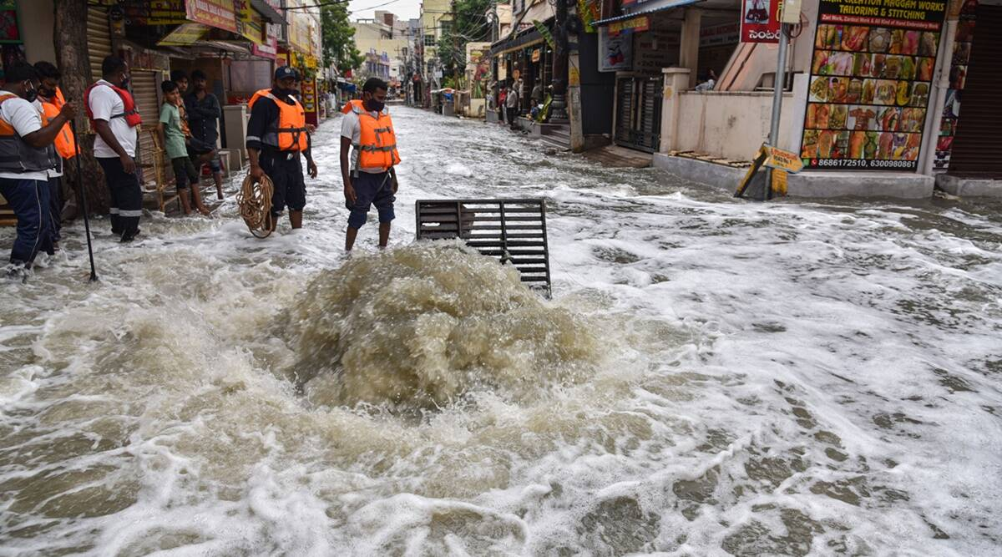
INTRODUCTION
During heavy rains, the drainage system gets overwhelmed due to:
High inflow of rainwater exceeding the drainage capacity.
Accumulation of wastage on the drains restricting the inflow of water.
Clogging of the drainage pipelines due to wastage
Overflowing Manhole

Slide 5
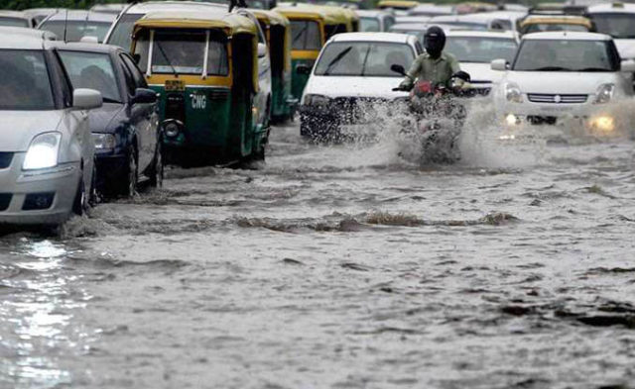
The inefficiency of the drainage system leads to:
Water logging on the roads causing traffic jams.
Road damage and property damage.
Inflow of water into houses and colonies.
Flash Floods.
Water logging on the road

Slide 6
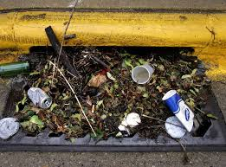
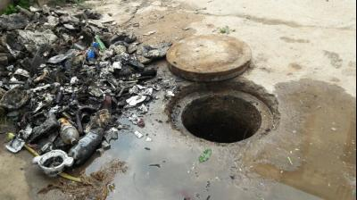
The Municipality workers are facing many difficulties in the maintenance of drains.
It becomes difficult for the workers to detect the clogged drain.
Detecting the clogged drain is time consuming as the roads are flooded with water.
Clearing the wastage from the drains is labor intensive.
Overtime working hours.
Lack of awareness on on-field situation.
Clogged drain with wastage restricting the inflow of water
Drain choked with plastic waste

Slide 7
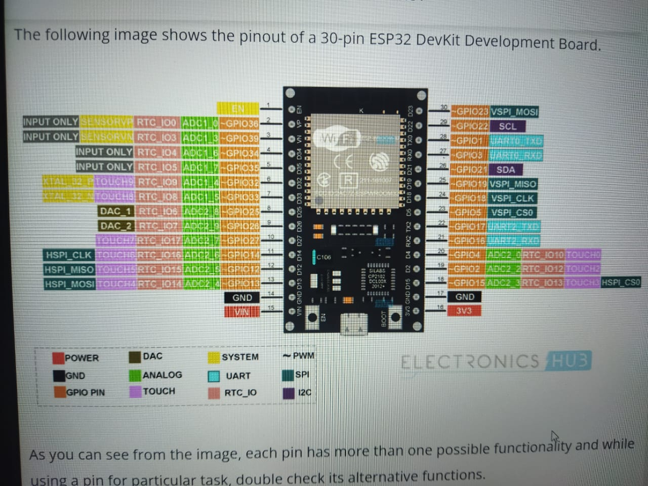
Fig: ESP32 Diagram

Slide 8
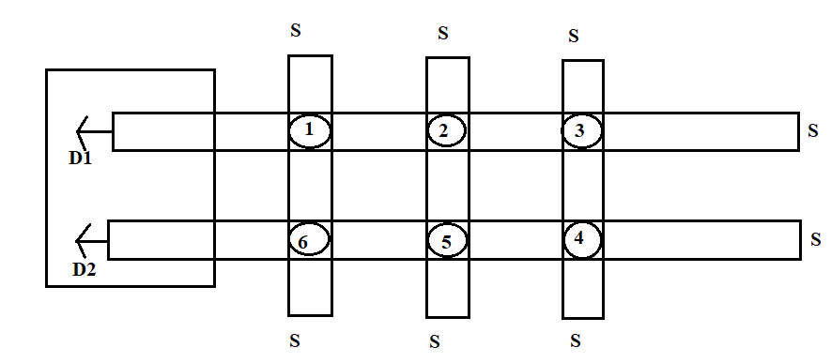
INTERFACE
Expected User Interface To see the flow of water

Slide 9
OBJECTIVES
Designing an effective manhole system.
Designing and Prototyping the sensor for block detection.
Integration of Sensors for monitoring the Flow
Design Implementation of Hardware of monitoring the Flow
Implementation of monitoring and alert Systems for Identification
User Interface Development for monitoring all the Nodes

Slide 10
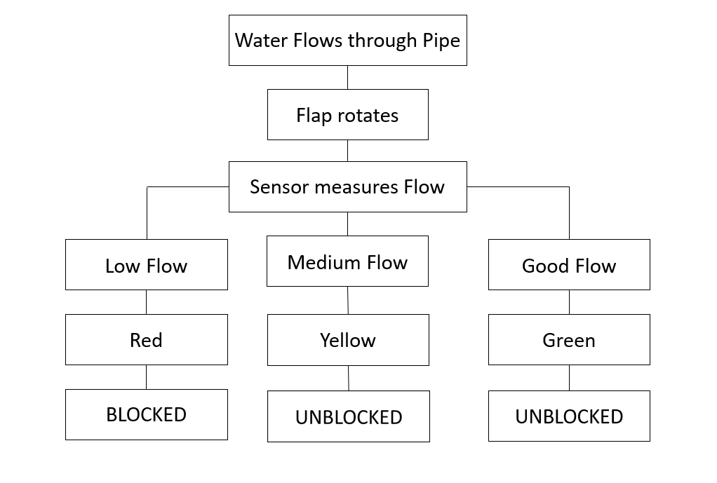
METHODOLOGY
The flap which is connected to the potentiometer rotates with the flow of water.
The data from the potentiometer is processed by a microcontroller and lights the LEDs.
Sensor Measures Flow of water

Slide 11
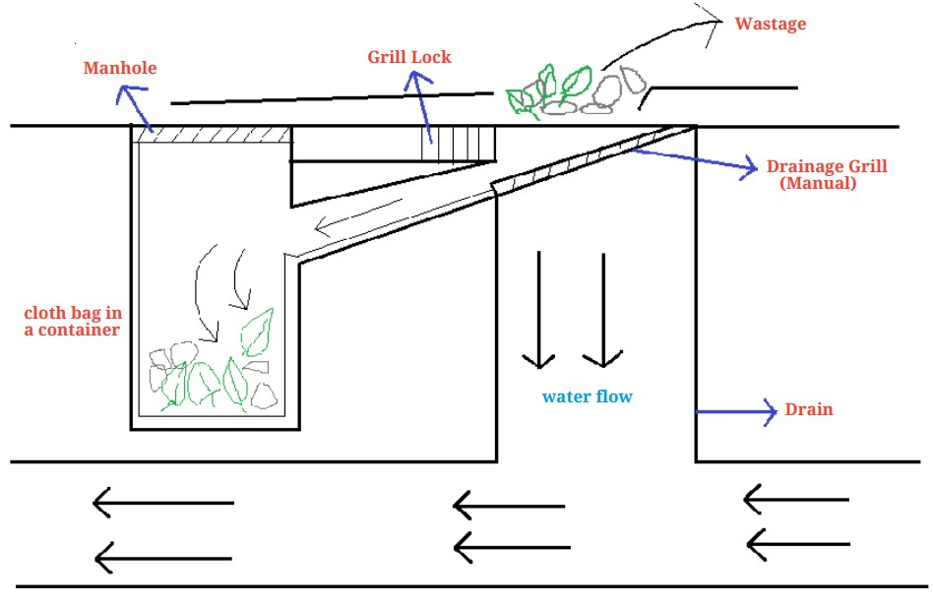
WORKING
The Inlet of the drain is opened to an angle of 30° manually during heavy rainfall.
It creates an alternate pathway for the rain water to flow.
Wastage along with the rain water flows into the container below the ground.
The waste is collected inside the cloth bag which is installed in the container.
The rain water flows into the drainage line contuniously without clogging.
The cloth bag with waste is replaced periodically.
It is completely safe to be installed on roads.
Design of Anti-Clogging Drain System

Slide 12
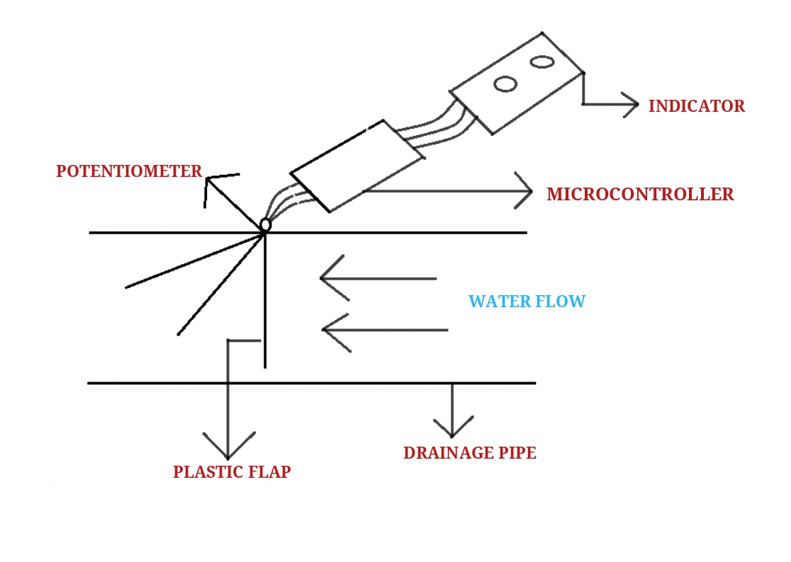
The Plastic Flap is connected to a Potentiometer. This system is installed in a drainage pipe.
The Flap rotates due to the water flow which in turn rotates the potentiometer.
The Spring attached behind the Flap ensures the Flap is at 0° when no Water flow.
The potentiometer data is processed by a Microcontroller.
The Microcontroller controls the LEDs on the ground which act as an indicator of the flow.
It is completely solar powered and only used during heavy rains.
It is inactive during other time which inturn saves battery.
It is easy to build and use.
Cost Effective.
Design of Block Detection sensor

Slide 13
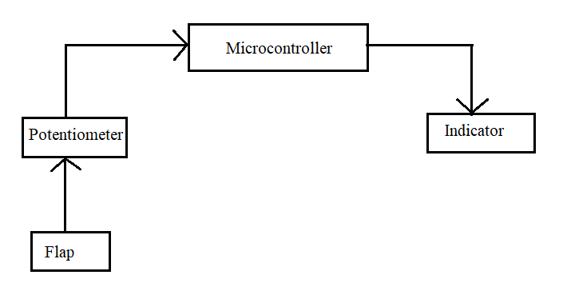
BLOCK DETECTION SENSOR:
Block Detection Sensor

Slide 14
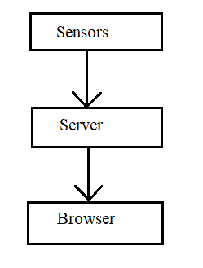
The proposed idea is to collect real-time data on drainage flow rates and patterns by integrating IoT devices. This data collection process will allow us to continuously monitor the drainage system's performance and quickly detect any irregularities. In addition, we intend to incorporate alert mechanisms into the system to provide early warnings of potential drainage network blockages or disruptions. Using IoT technology, these alerts will be sent instantly to relevant stakeholders, allowing for quick response and mitigation measures. The data collected by sensors, such as ESP, is stored and transmitted to a server. Through programming technologies, a user interface is developed to visualize the flow data. Potentiometers placed at various points detect values ranging from 1 to 1023, which are converted into percentages. The colours of the interface changes based on these percentages.
Block Diagram of Internal Operations to see User Interface

Slide 15
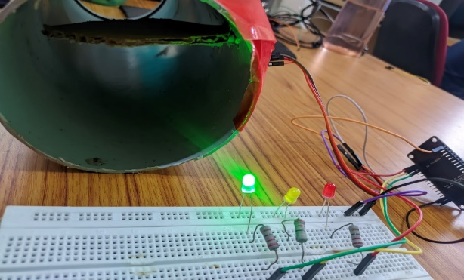
RESULTS
High Flow inside the pipe.
Flap is at 90°
The Indicator is Green.
LED Green Light glows Indicates that Flow of water is High

Slide 16
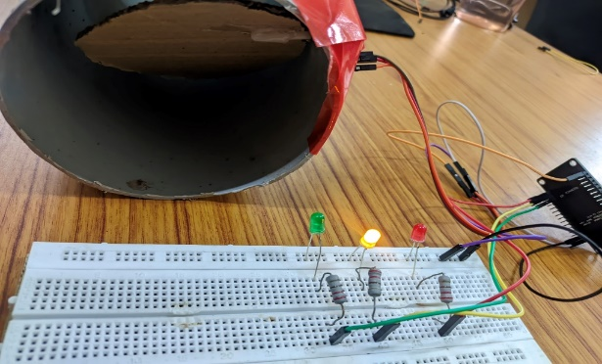
Medium Flow inside the pipe.
Flap is at 45°
The Indicator is Yellow.
LED Yellow Light glows Indicate that Flow of water is Moderate

Slide 17
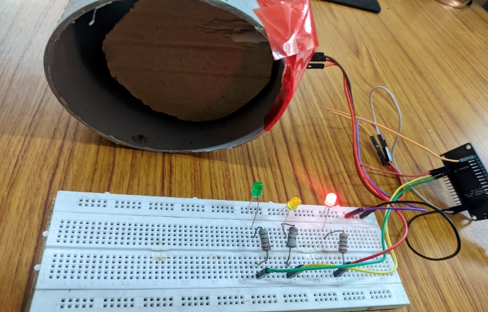
Low Flow inside the pipe.
Flap is at 0°
The Indicator is Red.
LED Red Light glows Indicate that flow of water is low

Slide 18
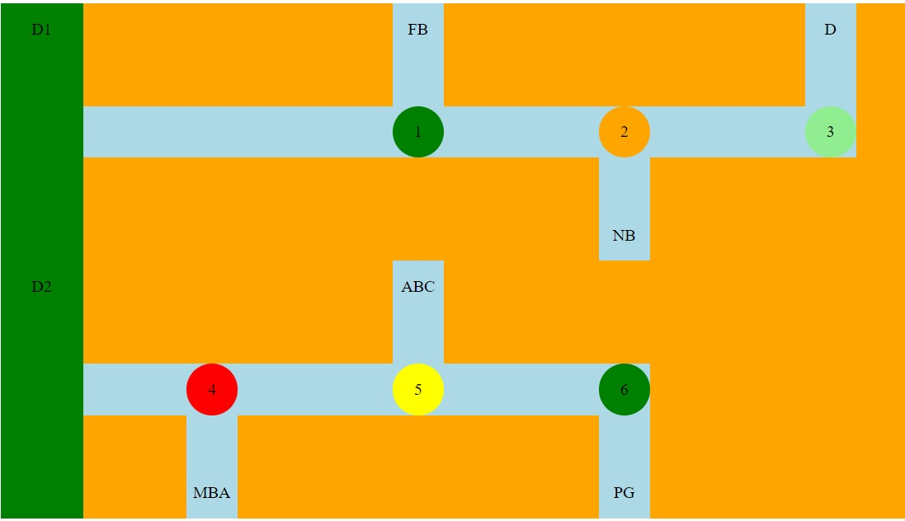
User Interface to see the flow of water

Slide 19
Conclusion and Future Work:
Addressing the challenges of underground monitoring, our project offers innovative methods for efficiently managing underground drainage systems. In addition to applications like real-time underground drainage and manhole identification, we have expanded our scope to include the development of a web-based user interface for monitoring water flow. This interface utilizes various sensors to detect flow rates categorized as high, low, and medium. These flow levels are visually indicated through LED colors, with red denoting low flow, green for high flow, and white for medium flow. By implementing this system, manual scavengers can optimize their efforts by quickly identifying areas of potential blockage through the intuitive user interface. This not only saves valuable time but also enhances safety measures by minimizing unnecessary trips into hazardous environments.

Slide 20
We aim to utilize GIS technology to accurately detect the location of drainage issues.
Another crucial aspect involves detecting harmful gases like carbon monoxide and methane emitted from choked waste materials, aiding in early intervention and mitigation efforts.
Furthermore, our idea will be concentrating on the consumption of water .
In addition to that, the removal of clog can be eradicated using robots. Instead of eradicating manually, the clog can be removed using robots to avoid hazards to humans.

Slide 21
REFERENCES:
T. Zaki, I. T. Jahan, M. S. Hossain and H. S. Narman, "An IoT-Based Complete Smart Drainage System for a Smart City," 2021 IEEE 12th Annual Information Technology, Electronics and Mobile Communication Conference (IEMCON), Vancouver, BC, Canada, 2021, pp. 0553-0558, DOI: 10.1109/IEMCON53756.2021.9623149.
Kamal Sahoo1, Janhvi Tambe, Shravani Patil, Abhishek Mathpati, Mrs. Prachi Kalpande “Smart Drainage System using IOT”, International Journal of Research Publication and Reviews, Vol 4, no 10, pp 2151-2155 October 2023, ISSN 2582-7421.
Tushar Pathak, Sanyogita Deshmukh, Pooja Reddy, Prof H.P.Rewatkar “Smart Drainage Monitoring and Controlling System Using IOT” (IJRES) ,Volume 9 Issue 7 ǁ 2021 ǁ PP. 23-29, ISSN 2320-9356.

Slide 22
Pavithra M, Gowtham P K, Jignesh M, Jayasubha K, JeevithaBrindha A, “IoT Based Underground Drainage Monitoring System”International Journal of Creative Research Thoughts (IJCRT) ” 2022 | IJCR |volume 10,Issue 5 May 2022 | ISSN:2320-2882.
9. Aditya Patel, Parth Dave, Aatish Patel “ Drainage Monitoring System Using IoT” International Journal for Research in Engineering Application and Management (IJREAM). Vol-06,Issue – 08,Nov 2020, ISSN:2454-9150.
10. M. Joseph Marcian1, S. Sabarishwaran1, D. Sudhagaran1, Dr. S. Sathiyapriya2 Smart Drainage Monitoring and Clog Removal Using IOT 2018 IJSRSET | Volume 4 | Issue 4 | Print ISSN: 2395-1990 | Online ISSN : 2394-4099.

